Slide 1
Data Visualization (Guide & Analysis)
UI Knowledge Transfer Deck

Slide 2
Technology Stack
Angular 1.5x
Typescript
D3 charts v 3.0
Fusion Chart
High chart
Bing map v 8.0
Node JS
SASS
Material Design
Web pack
Gulp

Slide 3
Plugins
Angular UI Grid
Angular Gridster
Express JS
JSDOM
Passport

Slide 4
IDE / Tools Used
GIT Extensions
VS Code
Advanced REST client
PostMan

Slide 5
Setting up the Environment
Clone the repo using GIT Extensions
https://data-viz.visualstudio.com/DataVizServer/_git/DataViz-UI
Import the project into VS code IDE

Slide 6
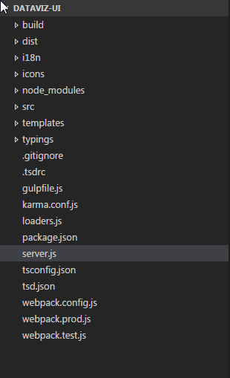
Package Structure

Slide 7
Code Walkthrough

Slide 8
Environments
Local (http://localhost:8080)
DeV (http://dev-dataviz-ui.azurewebsites.net)
QA (http://qa-dataviz-ui.azurewebsites.net)
Performance (http://px-dataviz-ui.azurewebsites.net)
Stage (http://stage-dataviz-ui.azurewebsites.net)

Slide 9
Team Details

Slide 10
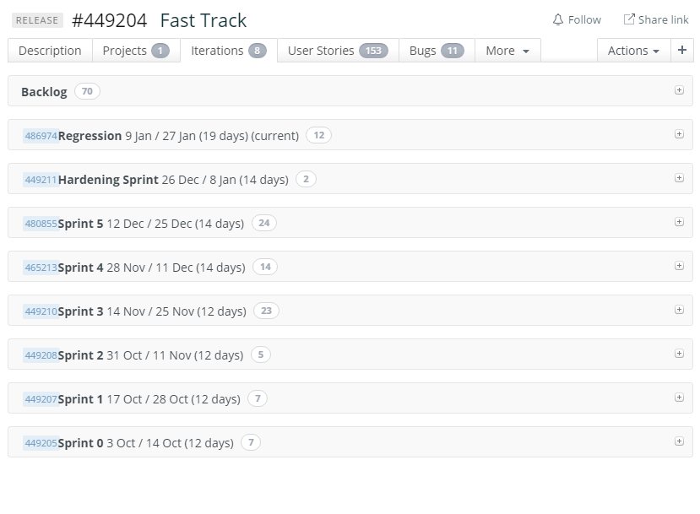
Drop1 - Release Details

Slide 11
Reference Link to Learn
https://www.typescriptlang.org/
http://expressjs.com/
https://www.seangwright.me/blog/development/angular-1-typescript-best-practices-part-1-components/
https://d3js.org/
https://www.npmjs.com/package/jsdom
http://www.highcharts.com/demo

